Slide 1
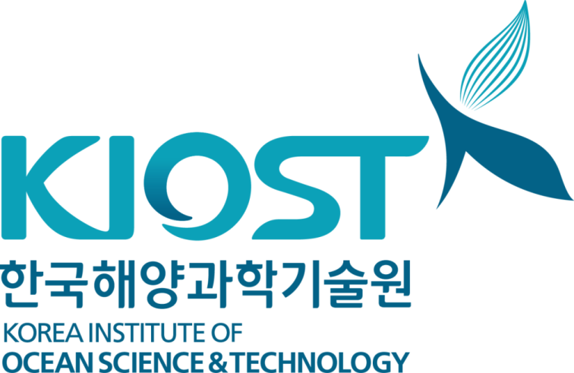
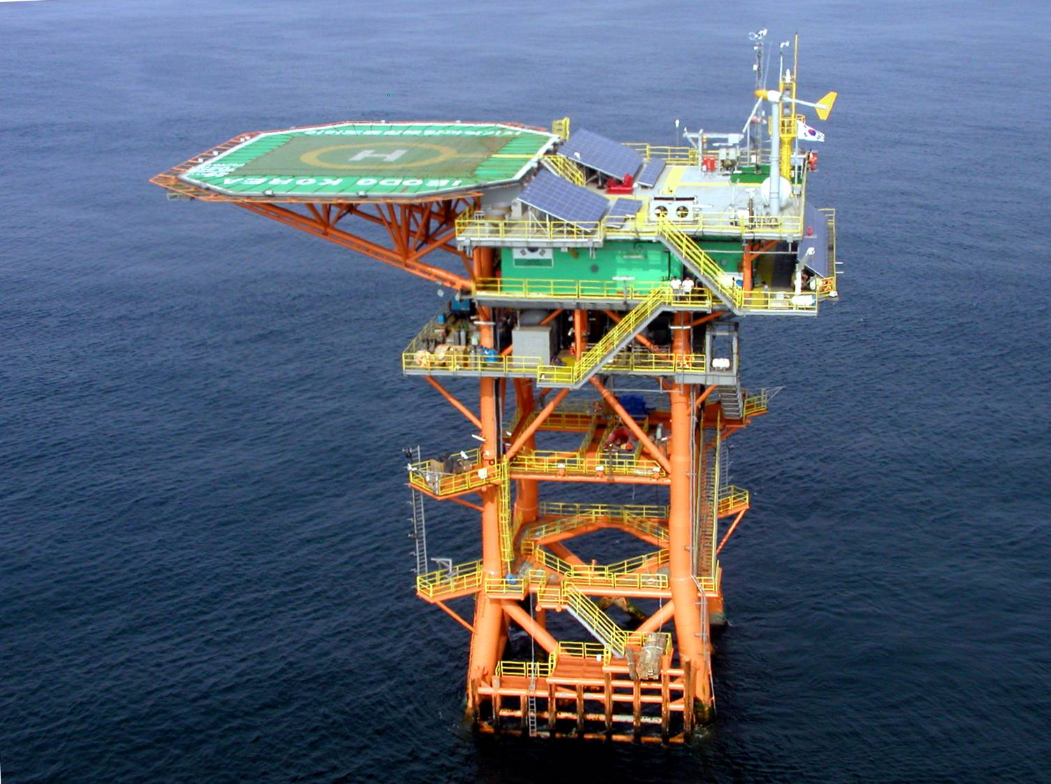
Introduction to the Ocean Research Stations in Korea
Jinyong Jeong¹, Jooyoung Lee², Jae-Seol Shim¹, Do-Seong Byun², JongMin Jeong¹
¹Korea Instiute of Ocean Science & Technology,
²Korea Hydrographic and Oceanographic Agency
Notes:
Thank you, chairman. I’m Jin-yong Jeong from Korea Institute of Ocean & Technology. The title of my presentation is ‘introduction to the Ieodo ocean research station and it’s application activities’
The project manager is Dr. Jae-Seol Shim, but he is not here, and I’m the project coordinator, here I stand to introduce you the Ieodo ocean research station.

Slide 2
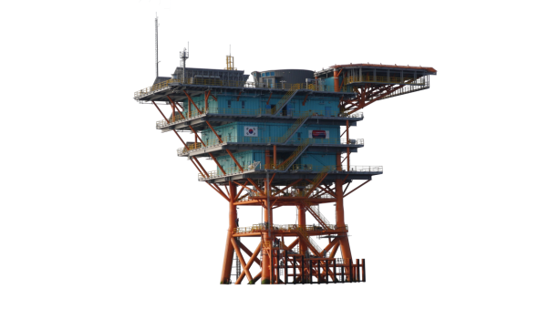
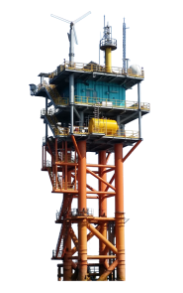
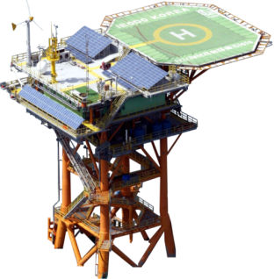
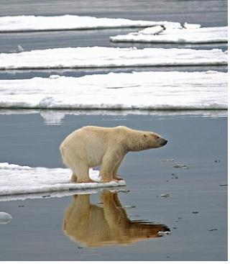
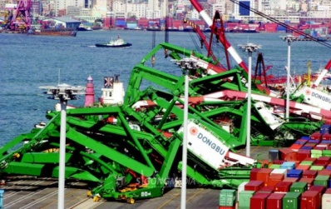
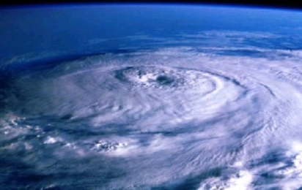
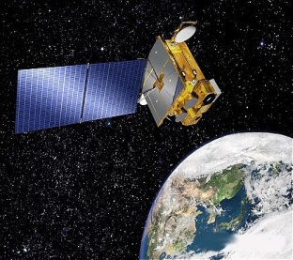
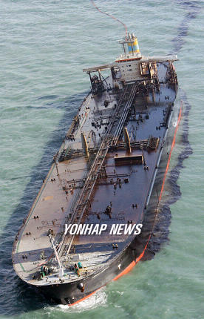
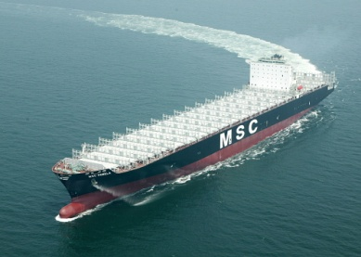
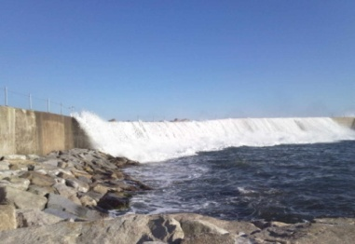
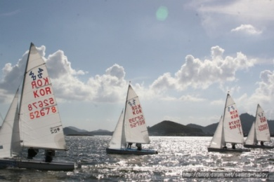
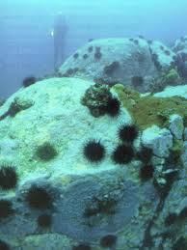
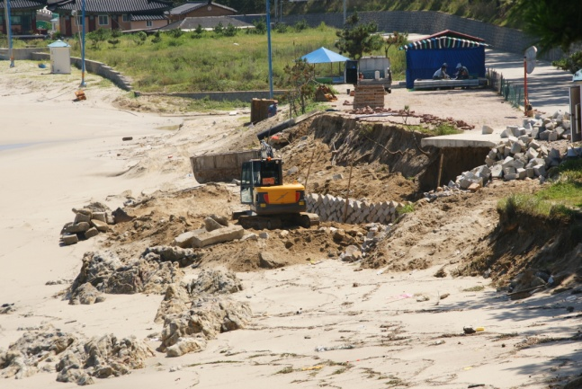
Background
Hardware
Software
Application Studies
Establishment of ORSs
KHOA, KIOST, Universities, marine companies,…
Long-term in-situ time series data
of interdisciplinary variables
Needs
Climate Change
Coastal Disaster
Typhoons
Cal/Val Remote Sensing
Oil spill
Marine Industry
Freak waves
Marine Leisure
Marine habitat
Coastal Erosion
Notes:
ORSs were established to obtain long-term in-situ time series data of interdisciplinary variables to understand various scientific and practical issues. ORSs are hardware part, and many scientists from KIOST, KHOA, Universities, and marine companies are doing application studies using the ORSs.

Slide 3
Overview
Program : “Construction of Ocean Research Stations and their Application Studies”
by KIOST (Korea Institute of Ocean Science & Technology)
Fund : MOF (Ministry of Oceans and Fisheries)
Own and Operation : KHOA (Korea Hydrographic and Oceanographic Agency)
3 Ocean Research Stations (ORS)
Ieodo ORS (Jun 2003)
Gageocho ORS (Oct 2009)
Socheongcho ORS (Oct 2014)
Features
Steel structure and fixed ocean platform (jacket & deck)
Powered by hybrid system (solar, wind + diesel generators)
Scientists can stay for several days in the ORSs
Ieodo
Gageocho
Socheongcho

Slide 4
Main applications
Improving comprehensive ocean and weather observations
Providing core scientific information and data for global environmental change studies in the Yellow Sea and East China Sea
Investigating typhoon behaviors and structures
Providing basic information for fisheries and ocean prediction as well as regional ocean studies
Functioning as a ground station of satellite ocean remote sensing work
Investigating movement and distribution of atmospheric constituents such as Asian dust (yellow dust)
Investigating offshore structure stability in bad and extreme weather conditions
Providing a base facility for search and rescue as well as a functioning as a light house for navigation safety

Slide 5
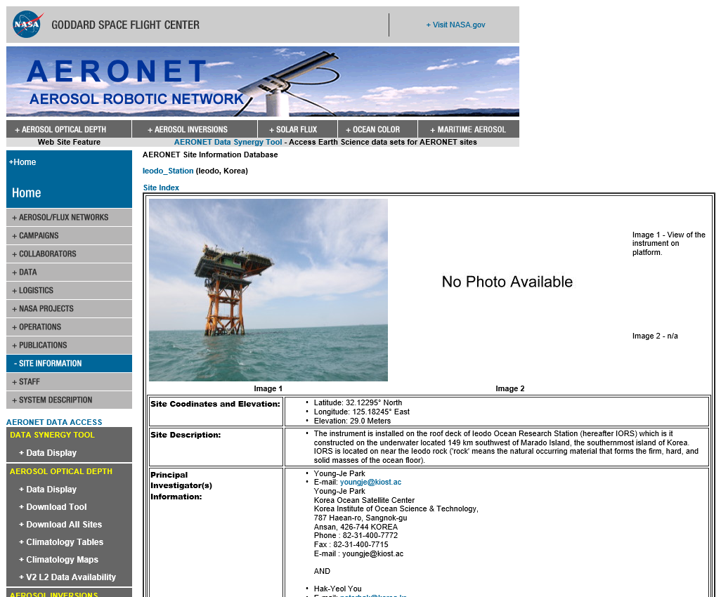
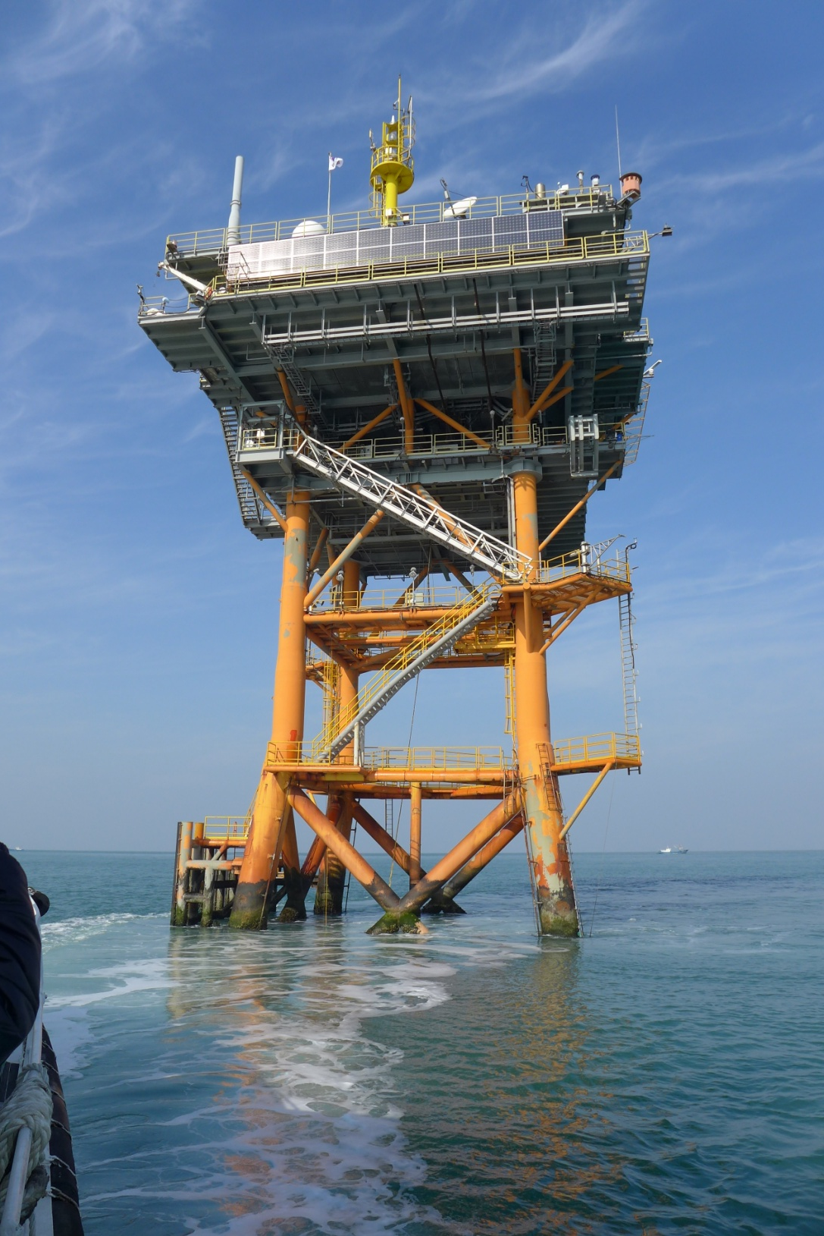
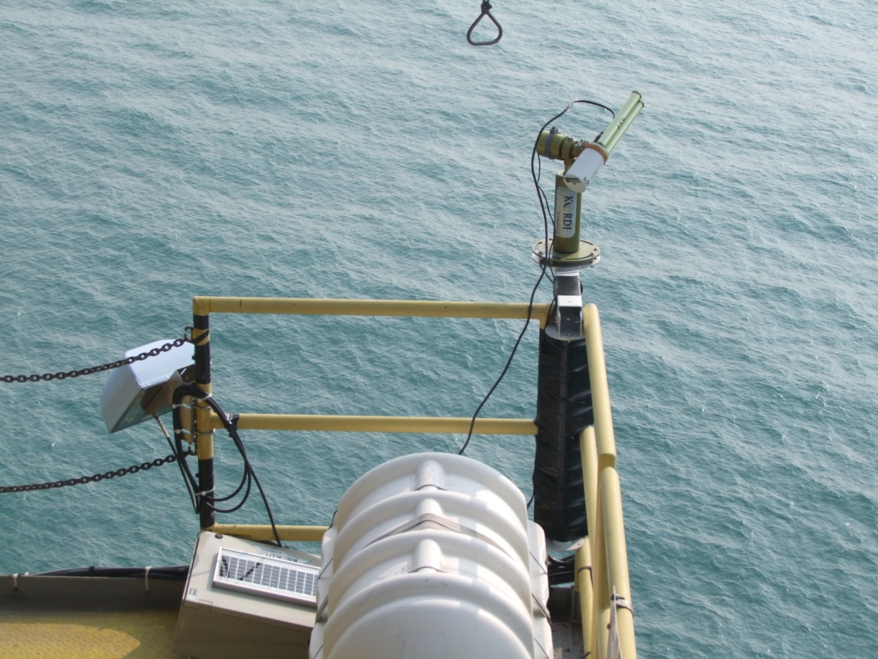
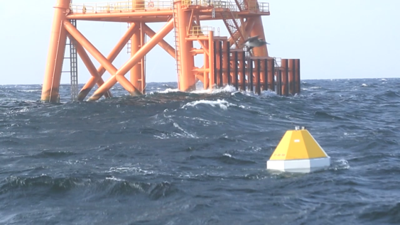
Global Observation Networks
AERONET-OC (AErosol RObotic NETwork – Ocean Color)
Ieodo ORS (2014)
GOA-ON (Global Ocean Acidification Observing Network)
Socheongcho ORS buoy system
Yellow Sea : Korea OA station1

Slide 6
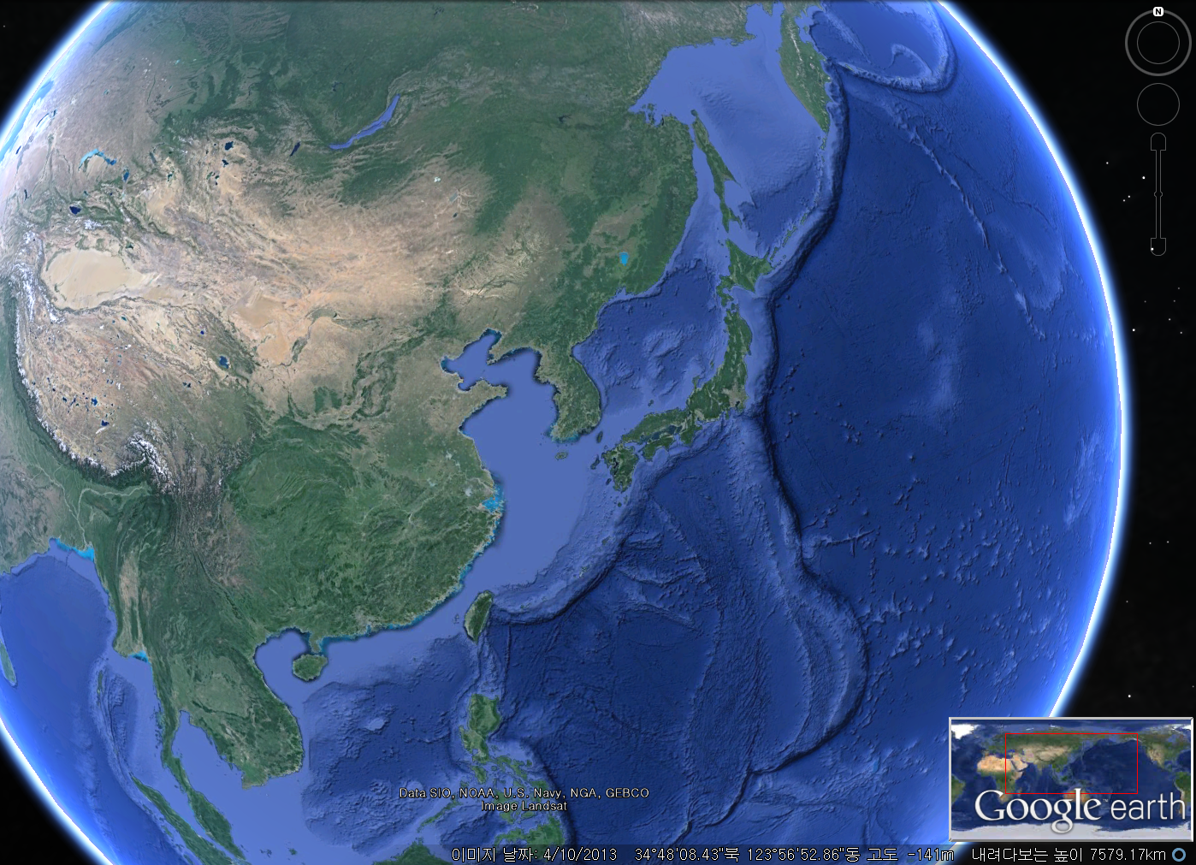
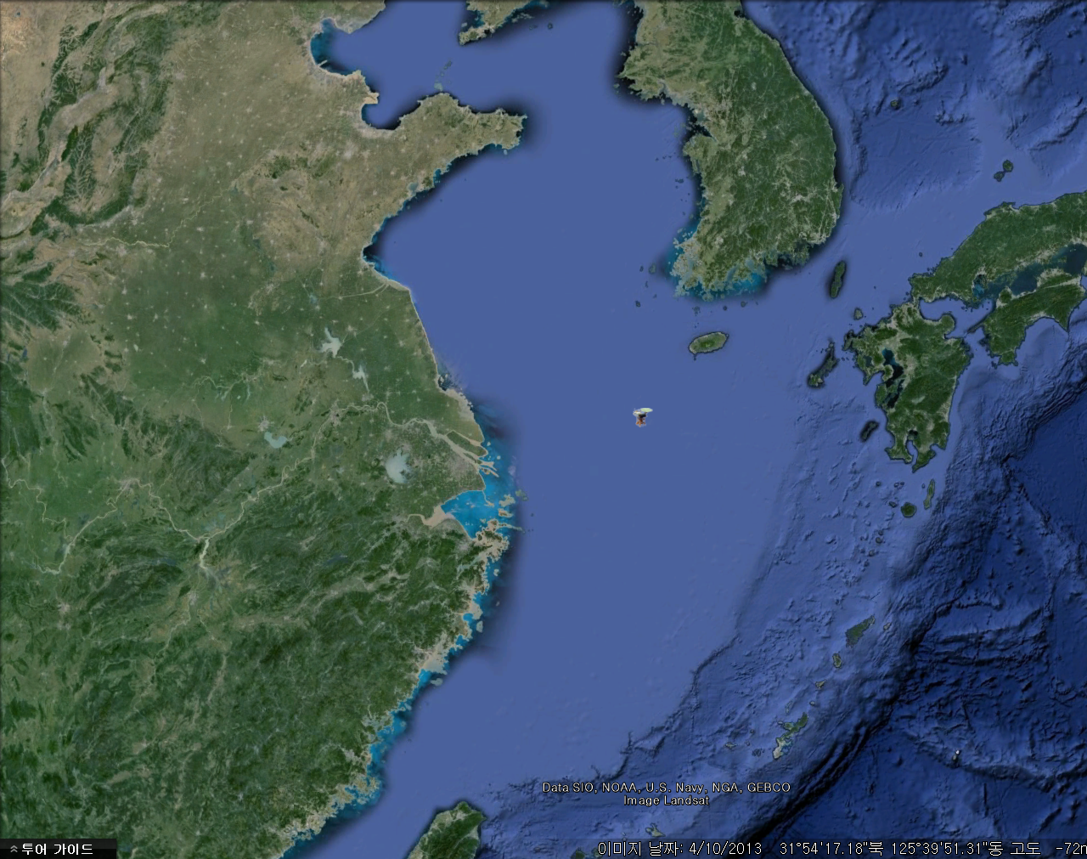
Location of the Ocean Research Stations in Korea
Korea
China
Japan
Typhoons
Located in the Yellow Sea & East China Sea
On the track of major typhoons affecting the Korean peninsula
(about half of the typhoons had passed the IORS)
No Land around the IORS within 150 km

Slide 7
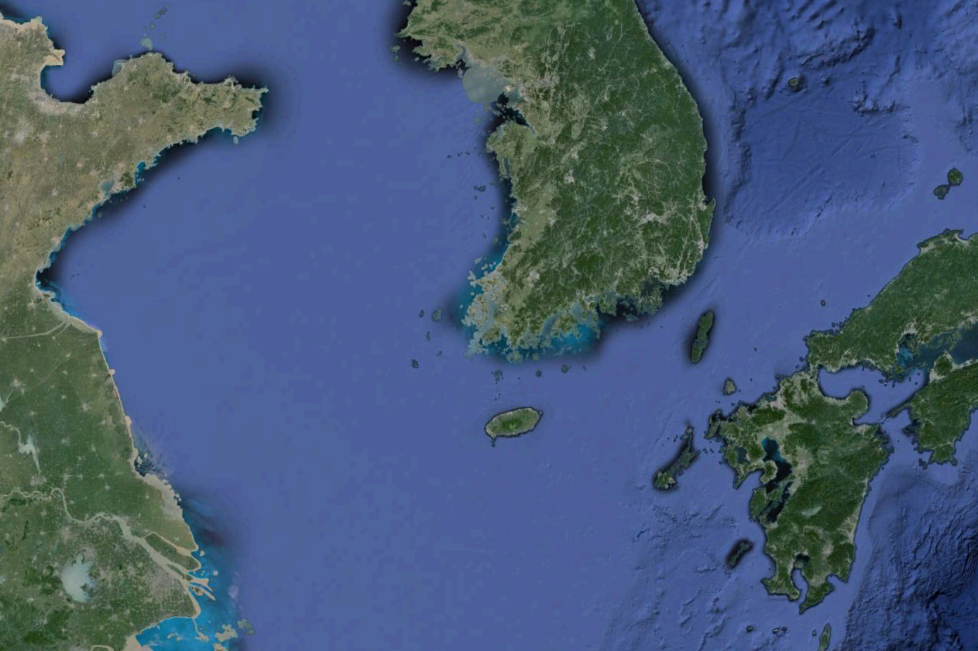
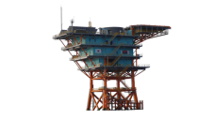
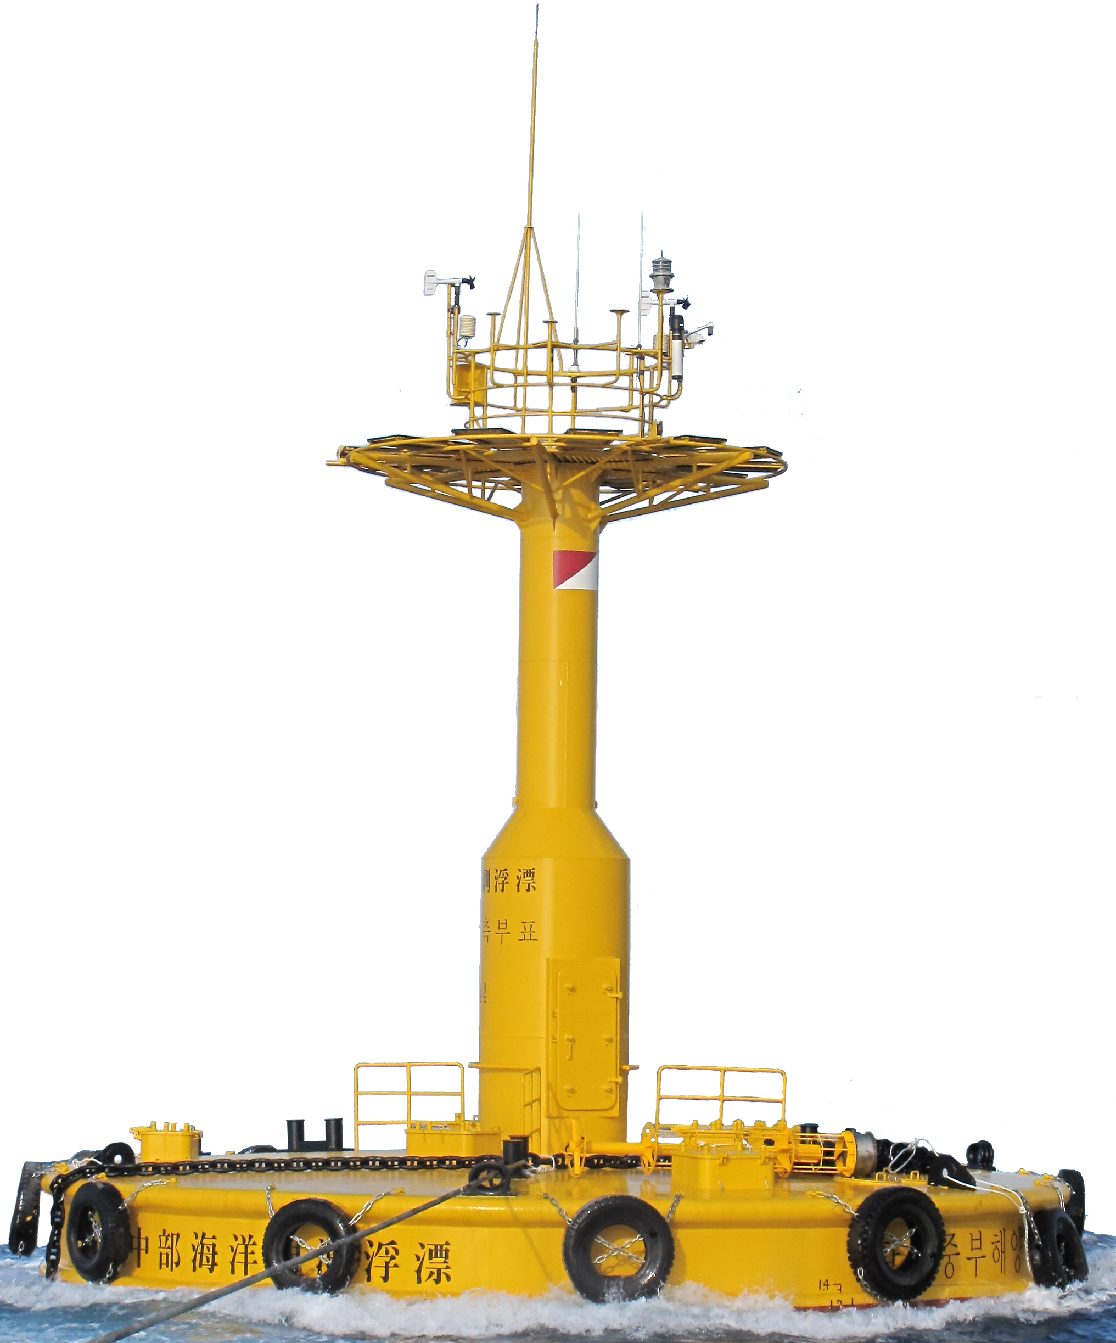
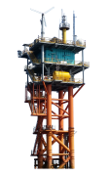
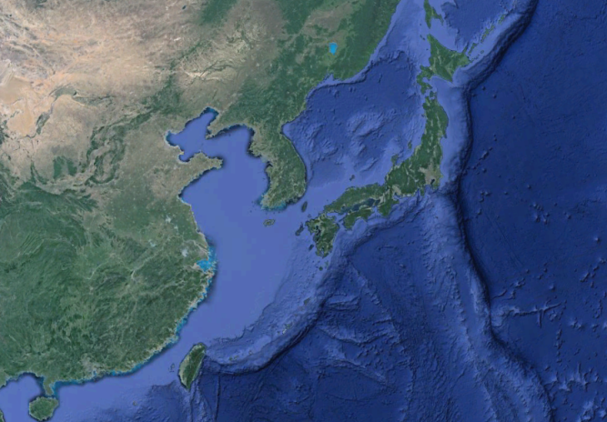
Location of the Ocean Research Stations in Korea
37 km south of Socheong Island
Depth : 50 m
Completed in Oct. 2014
Socheongcho
Korea
190 km west of Gunsan city
Depth : 80 m
Moored in Sep. 2007
Yellow Sea Buoy
47 km south-west of Gageo Island
Depth : 15 m
Completed in Oct. 2009
Gageocho
149 km south-west of Mara Island of Jeju
Depth : 41 m
Completed in Jun. 2003
Korea
Japan
China
Ieodo
Notes:
Because the purpose and functions of the ORSs are almost identical with each other, I will focus on the IORS as the representative.

Slide 8
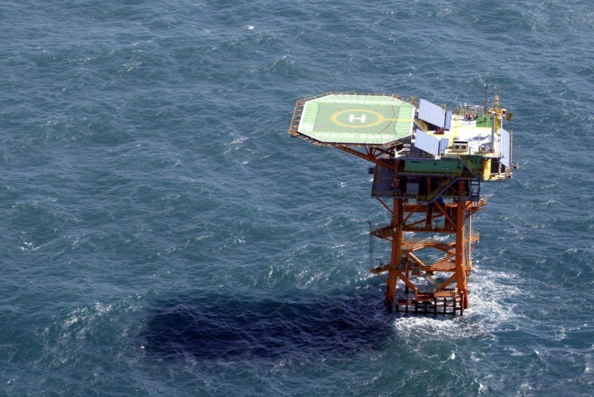
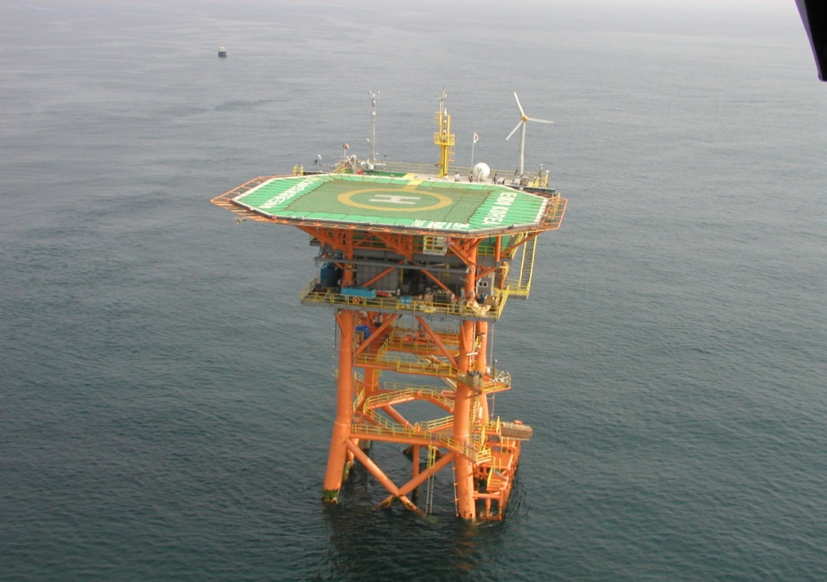
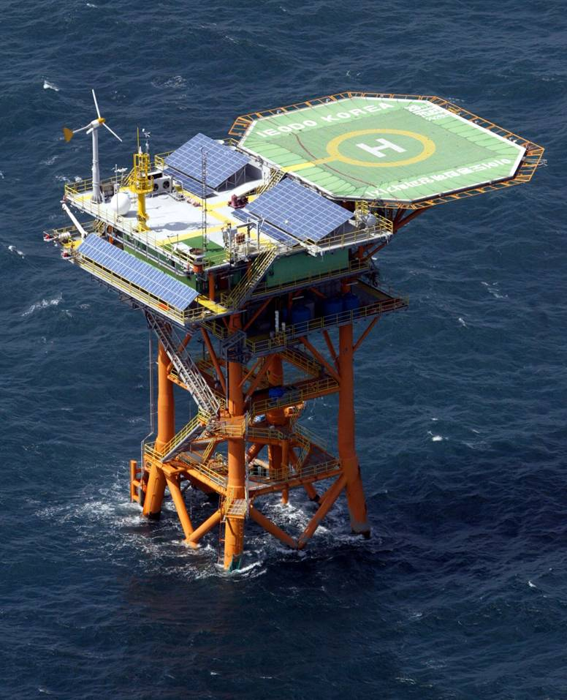
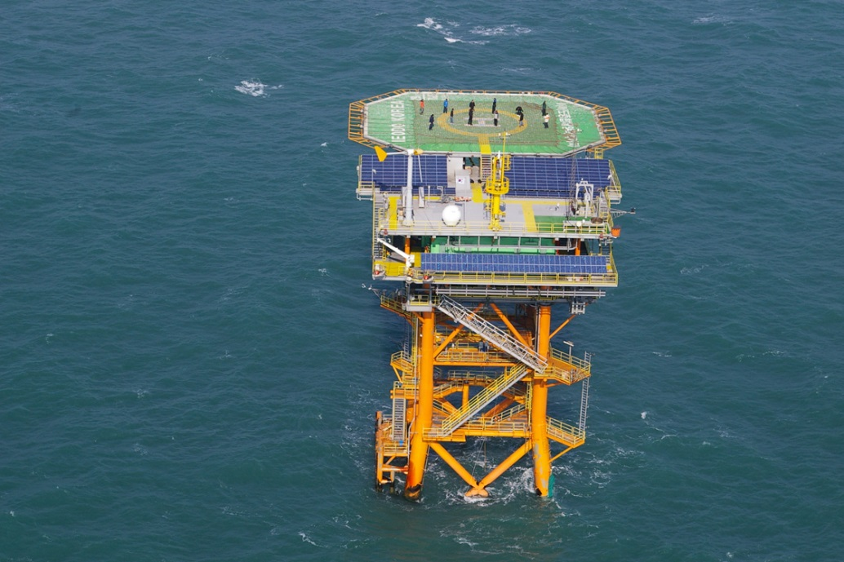
The Ieodo Ocean Research Station (The IORS)

Slide 9
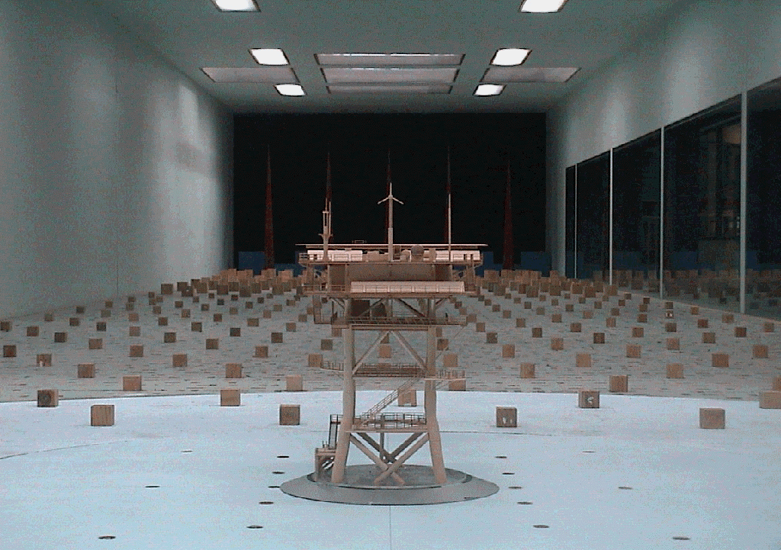
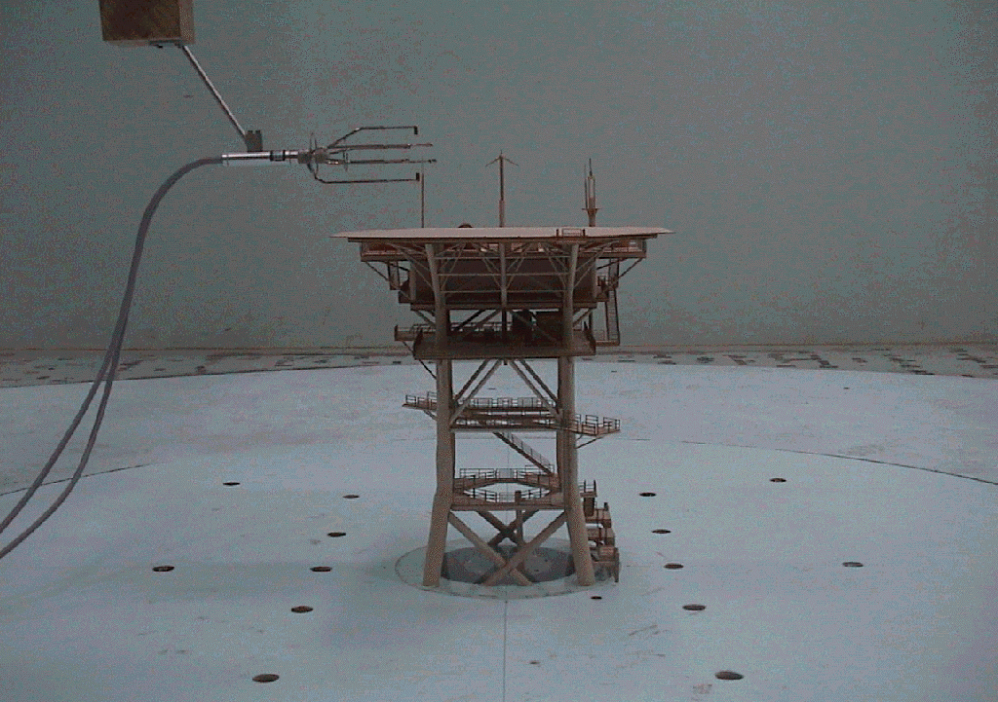
The IORS : Design
Hydraulic experiment
Wind tunnel experiment

Slide 10
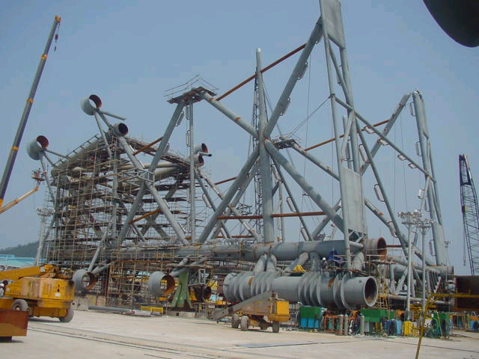
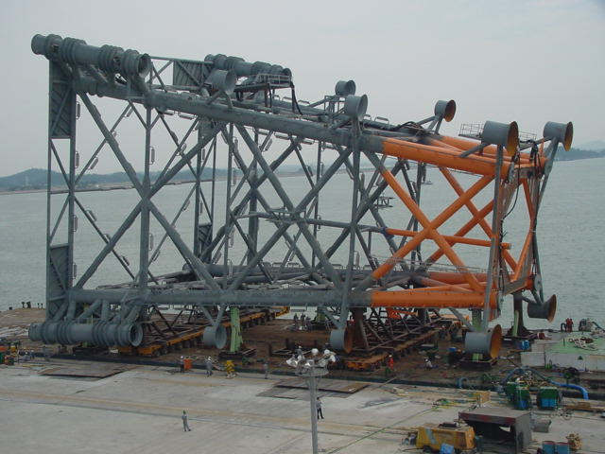
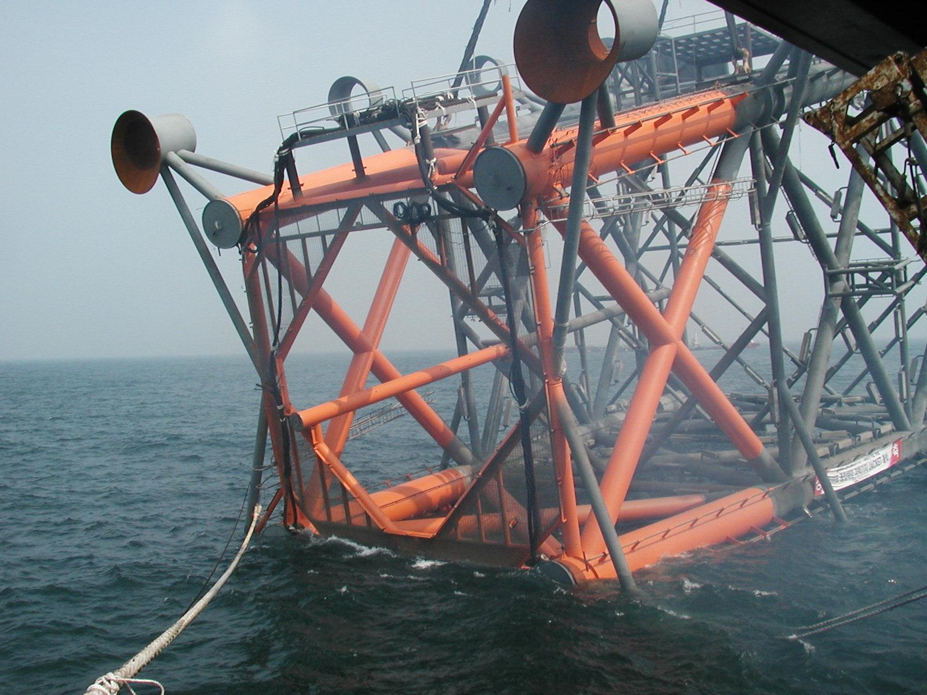
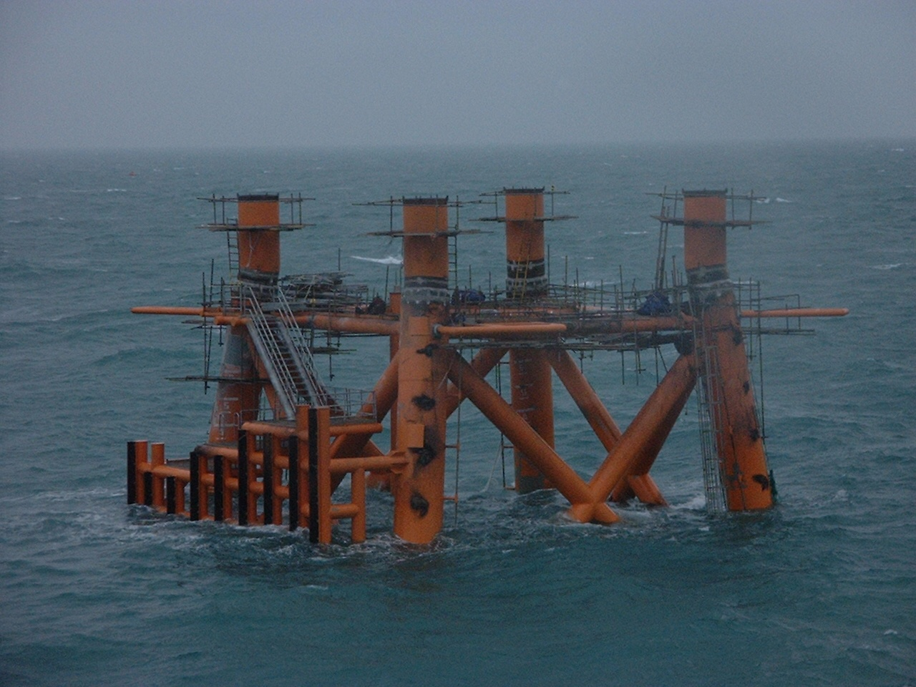
The IORS : Construction & Installation

Slide 11
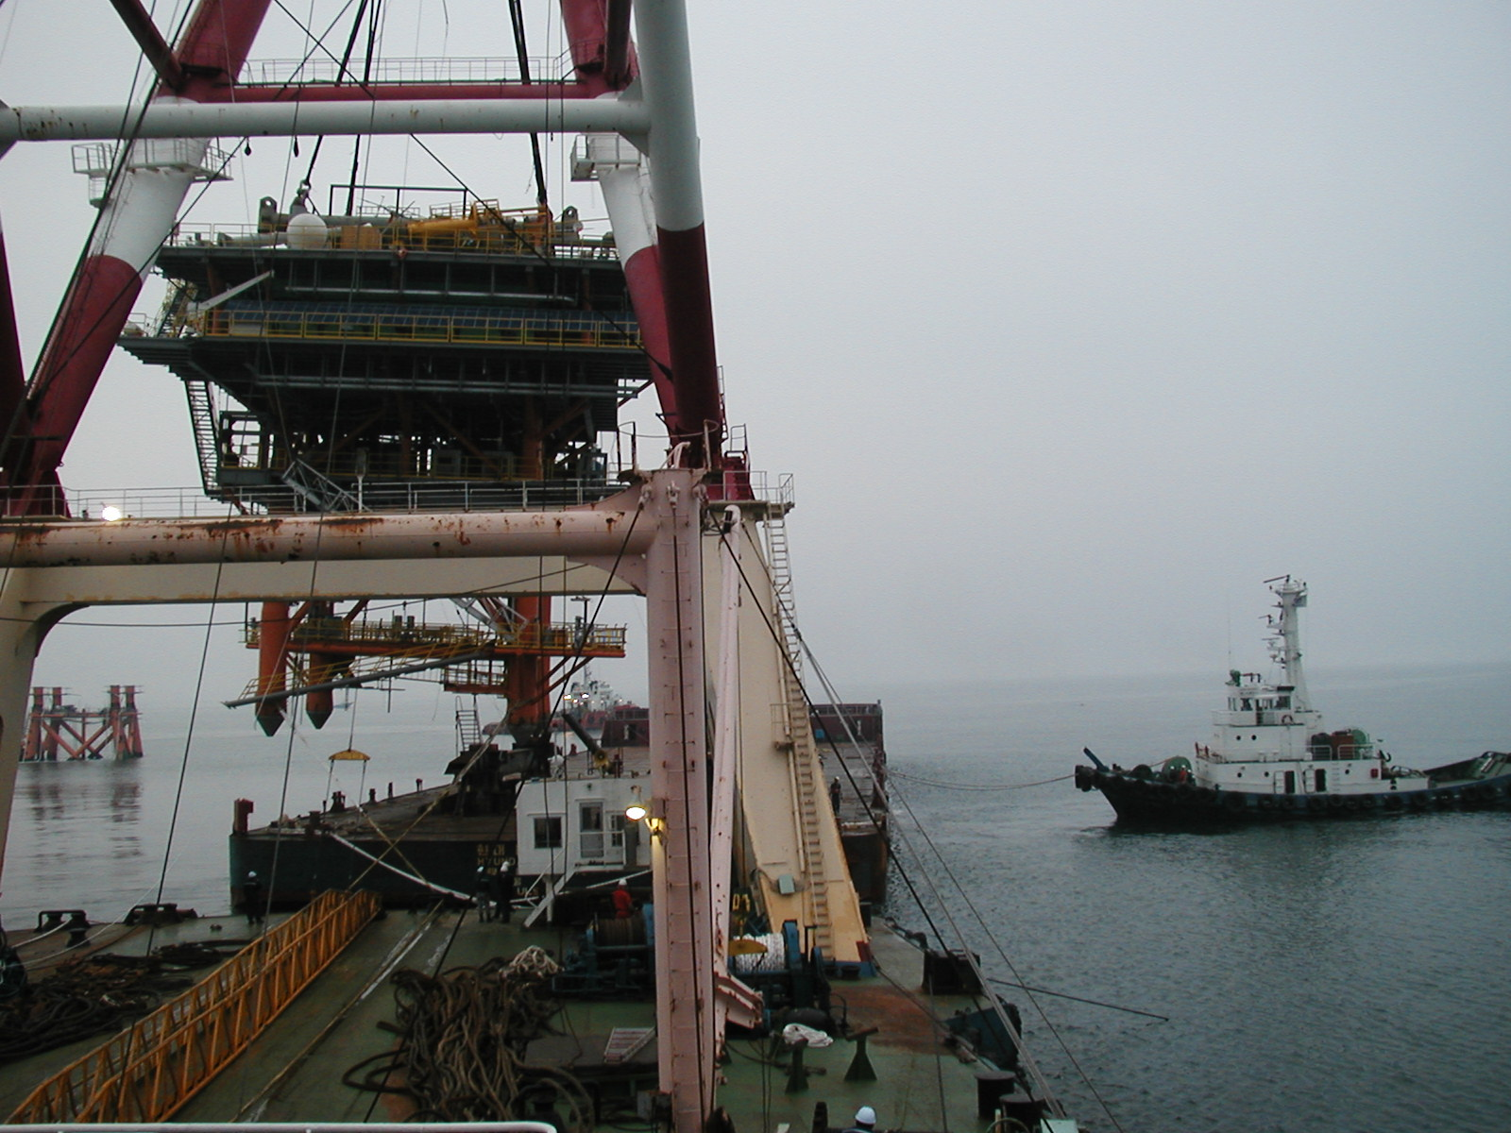
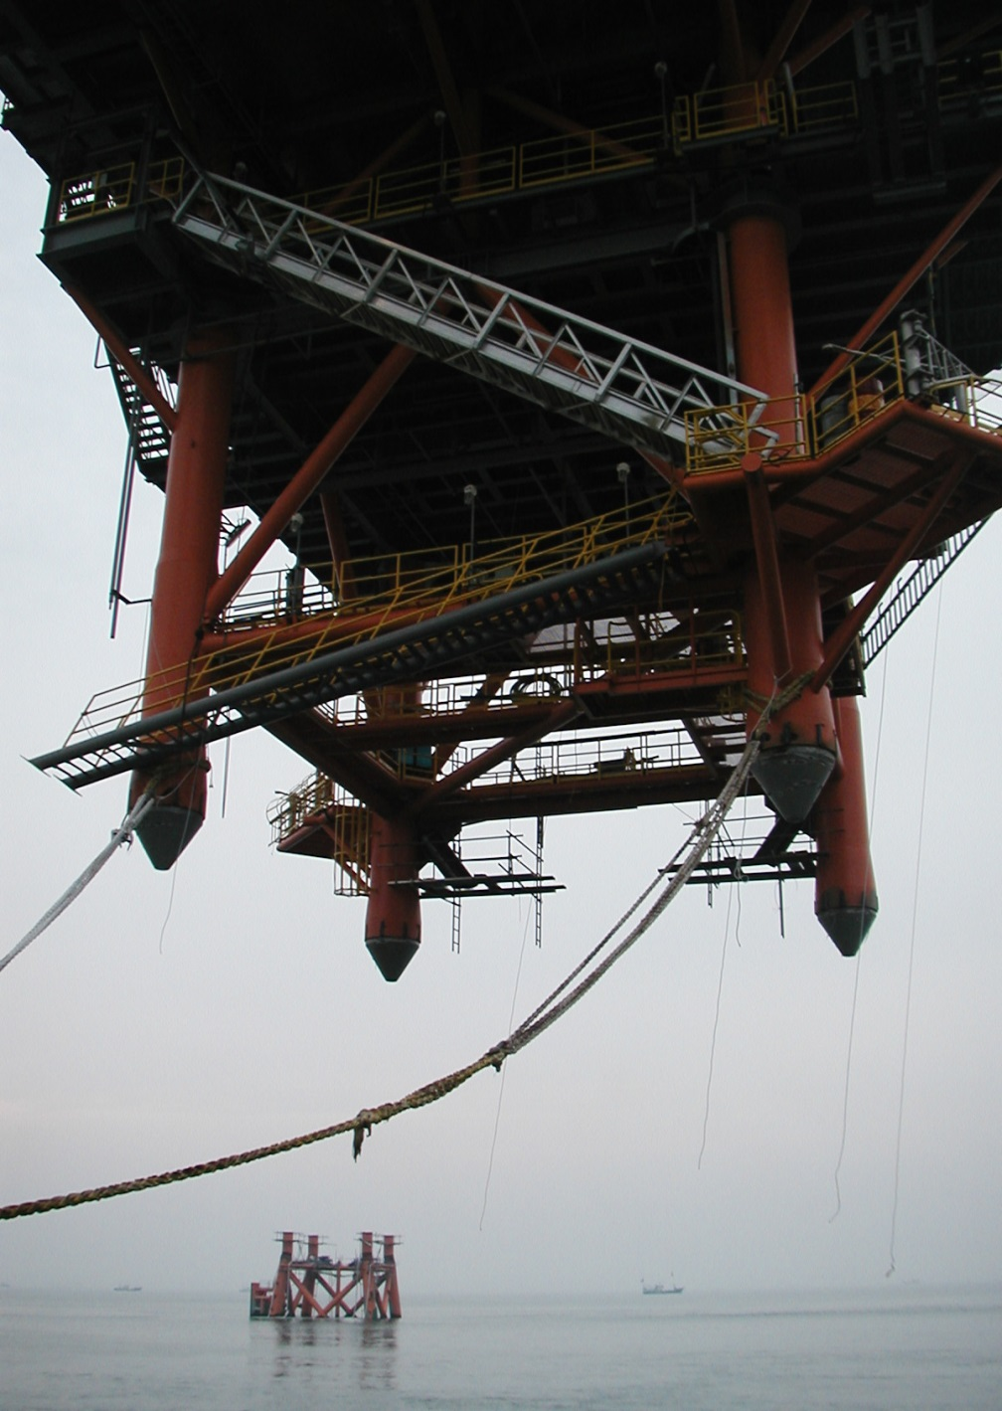
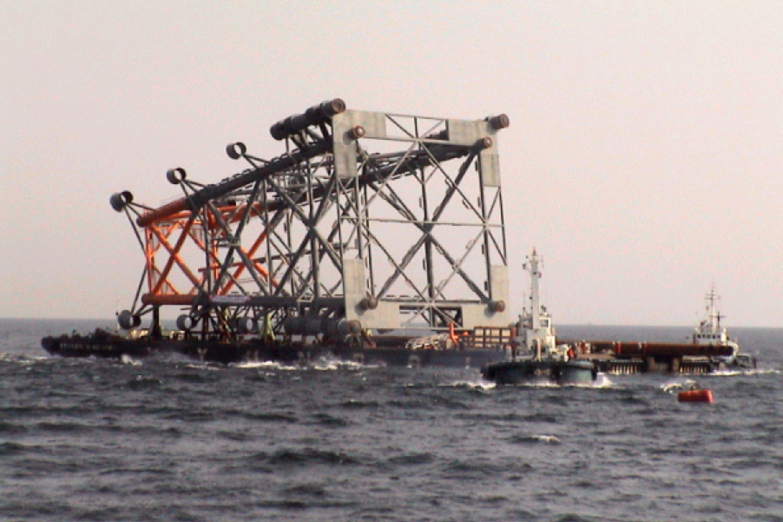
The IORS : Completion

Slide 12
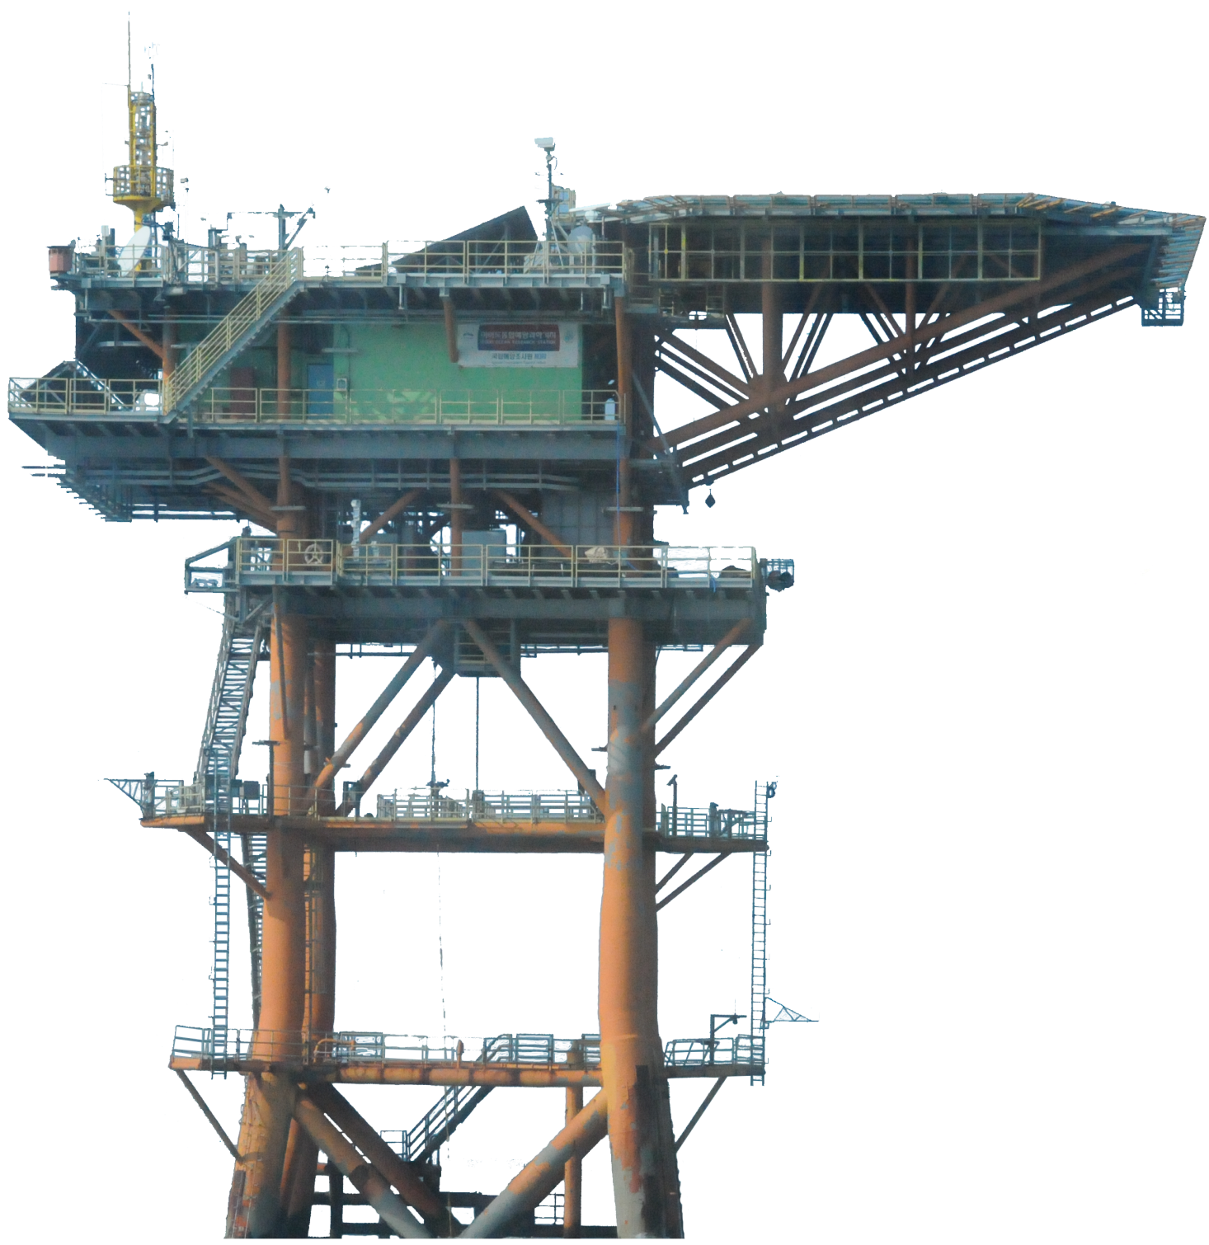
The IORS
Heli Deck
36m
Roof Deck
33.5m
Main Deck
29m
Completion : Year 2003 (1995~2003)
Depth : 41 m (Total Height : 77m)
Total area 1,345㎡
Total weight 3,400 tonnes
Instruments : 35 different kinds
(atmospheric, oceanographic, environmental, structural)
Cellar Deck
24m
Intermediate Deck
16m
Bottom Deck
8m
Boat Landing
2m
CTD (5m)
CTD (10m)
CTD (20m)
41m
CTD (30m)
CTD (40m)
Weight (100 kg)
ADCP
(planning)

Slide 13
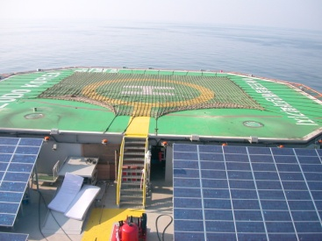
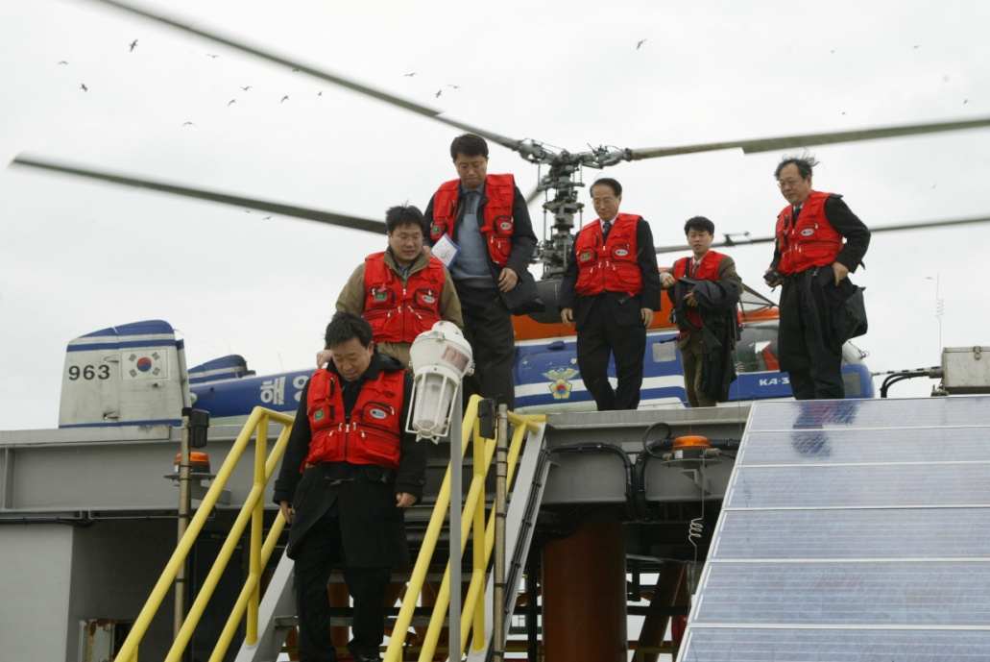
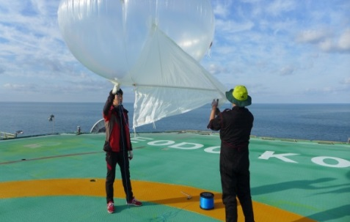
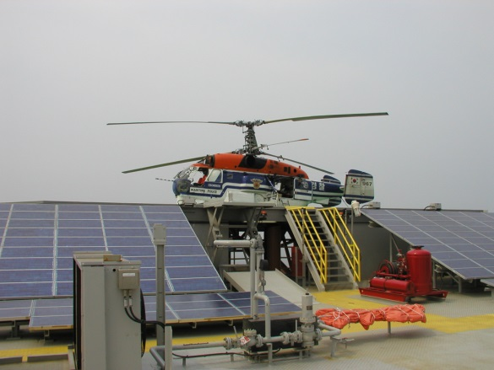
The IORS : Heli-Deck
Heli Deck
36m
33.5m
29m
24m
16m
8m
CTD (5m)
CTD (10m)
CTD (20m)
Heli-Deck which can let researchers to get easy access to the IORS
Search and rescue
Atmospheric experiments
CTD (30m)
CTD (40m)
Weight (100 kg)

Slide 14
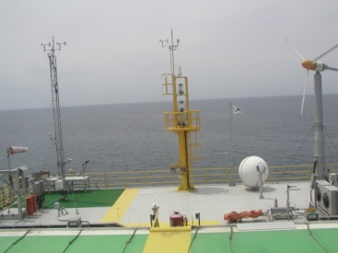
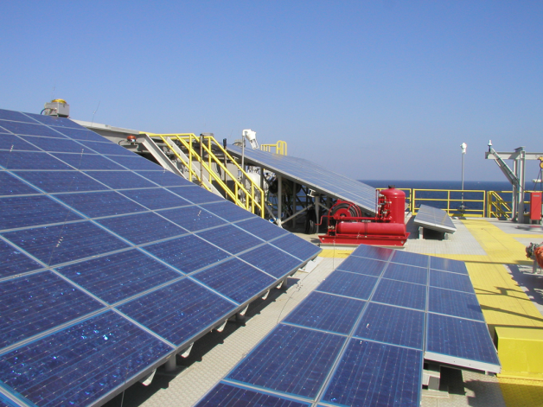
The IORS : Roof Deck
36m
Roof Deck
33.5m
29m
24m
16m
8m
2m
CTD (5m)
Light house, MET. tower & table, wind turbine, and solar panels
Satellite antenna for data transmission
CTD (10m)
CTD (20m)
41m
CTD (30m)
CTD (40m)
Weight (100 kg)
ADCP
(planning)

Slide 15
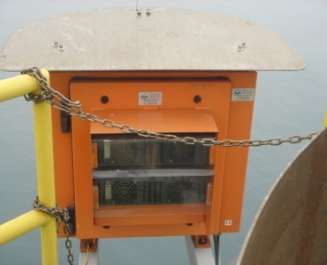
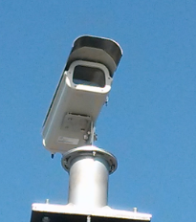
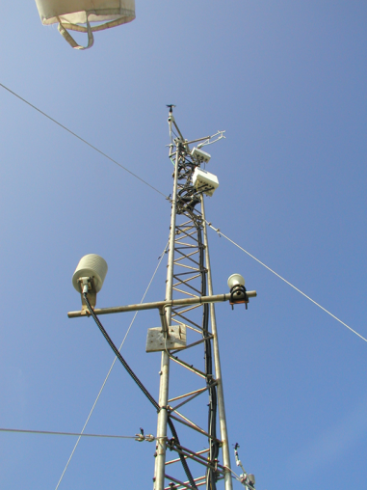
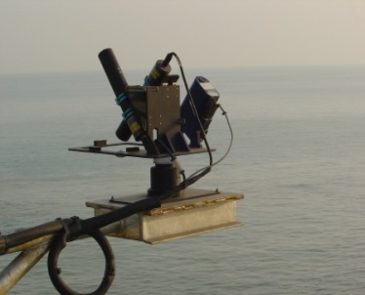
The IORS : Roof Deck
Wind Monitor
Thermometer & Hygrometer
43 m
36m
Barometer
Roof Deck
33.5m
Pyranometer
Main Deck
29m
Ultraviolet Radiometer
Cellar Deck
Sunshine Duration Meter
24m
Rain Gauge
37 m
Intermediate Deck
Ceilometer
Wave Radar
16m
Present Weather Detector
Radioactivity Sensor
8m
2m
CTD (5m)
Camera
CTD (10m)
CTD (20m)
Spectroradio Meter
IR Thermometer
CTD (30m)
CTD (40m)
Weight (100 kg)

Slide 16
The IORS : Main Deck
36m
33.5m
Main Deck
29m
24m
16m
Sea Level Monitor
8m
2m
CTD (5m)
CTD (10m)
AERONET-OC
System
CTD (20m)
CTD (30m)
Control room, battery & switch gear room
Scientist accommodation and bath
Kitchen and conference room
12 peoples can stay for more than 2-wks without additional supplies
CTD (40m)

Slide 17
The IORS : Cellar Deck
36m
33.5m
29m
Cellar Deck
24m
16m
8m
2m
CTD (5m)
CTD (10m)
CTD (20m)
Diesel generator, desalinator, water purifier
Small boat and underwater activity supporting equipments
CTD (30m)
CTD (40m)
Weight (100 kg)

Slide 18
The IORS : Intermediate Deck
36m
33.5m
29m
24m
Intermediate Deck
16m
8m
2m
CTD (5m)
CTD (10m)
CSAT (flux)
NW & SE
CTD (20m)
CTD (30m)
Winch system for underwater monitoring sensors (CTD, turbidity & fluorescence sensors,…)
CTD (40m)
Weight (100 kg)

Slide 19
The IORS : Bottom Deck & boat landing
36m
33.5m
29m
24m
16m
Bottom Deck
8m
Boat Landing
2m
CTD (5m)
CTD (10m)
CTD (20m)
CTD (30m)
Observation platform
NW & SE
CTD (40m)
Weight (100 kg)

Slide 20
Science themes related to the IORS

Slide 21
Sensors
 | Instruments / Models | Parameters
Oceano-graphic | CTD / 19plus&Auxiliary | Profile of Water Temp, Salinity, PAR, Fluorescence, DO
 | CT D / SBE37SM & SBE39 | Surface Water Temperature & Salinity
 | CTD / RBR Concerto CTD | Temperature & Salinity
 | CT / Aannderaa CTD | Temperature & Salinity
 | IR Sensor / KT19.85 II | Surface Water Temp(IR)
 | ADCP / WHS300 | Ocean Current Profile
 | WAVE RADAR /SM-050 | Wave, Period, Wave direction, Spectrum
 | Range Finder / SM-140 | Sea level height, Wave, Period
 | Sea Prism / Spectro-Photometer | Ocean color
 | Hyperspectral Radiometer / RAMSE | Intensity of radiation
 | UV fluorometer / MicroFlu-CDOM | Colored dissolved organic matter
 | Fluorometer / ECO FLNTU | Chlorophyll
 | UV NITRATE Sensor/ SUNA V2 | Nitrate
 | Fluorometer / In situ FIRe | Fluorescence
 | Fast Ocean system / FRRf | Fluorescence Profile
 | DO Sensor / 43 | Dissolved oxygen
 | Underwater sound Sensor | Underwater sound monitoring
 | Instruments / Models | Parameters
Meteoro- Logical | Wind Monitor/ 01506 | Wind Speed & Direction,
 | Ultrasonic Wind / VENTUS | Wind Speed & Direction,
 | Anenometer / HMP155 | Temp, Humidity
 | Barometer / PTB210B | Atmospheric pressure
 | Insolation Sensor / CMP21 | Insolation
 | Sunshine Sensor / CSD3 | Duration of sunshine
 | Ultraviolet solar radiation Sensor / CUV5 | Ultraviolet rays
 | Rainfall Sensor / ERG(H) | Rainfall
 | Visibility meter / PWD-22 | Visibility
 | Ceilometer / CL31 | Cloud
 | Multi weather sensor / WS600 | Wind, Temp, Humidity, Atmospheric pressure
 | 3dimension wind / CSAT3 | 3dimension wind
Atmospheric Environment | Ultrafine particles sensor / FH62C14 | PM2.5 monitoring
 | O3 analyzer / 49i | O3 monitoring
 | Gas Analyzer / EC-150 | CO2, H2O
 | Environmental radiation / EFRD 3500 | Environmental radiation
 | Black carbon sensor / 5012 | BC monitoring
 | CO, CO2, H2O, CH4 monitoring / G2401 | CO, CO2, H2O, CH4 monitoring
Structure Monitoring | Accelerometer / Accelerometer | Structure acceleration
 | Clinometer / Clinometer | Structure gradient
 | GNSS / GR25 | Structure displacement

Slide 22
Data Management
1. Primary QC : Range Check
Sensor range
Regional and seasonal range
2. Secondary QC : Standard Deviation Check
2 ~ 5σ, varied by variables
3. Secondary QC : Standard Deviation Check with Moving Average
1~7 days, varied by variables
4. Secondary QC : Stuck Sensor
Remove continuous error values
5. Eye Check
By experts

Slide 23
Data Management
OceanSITES
Ieodo
Socheongcho
Gageocho

Slide 24
Data (http://sms.khoa.go.kr/koofs/eng/observation/obs_real_map.asp)
Ieodo ORS

Slide 25
Researches: Ocean Mixed Layer
MLD
25

Slide 26
Researches: Validate reanalysis & remote sensing data
Muipa
Bolaven
Damrey
Tembin
Reanalysis data (HYCOM, FNMOC-M, JCOPE2)
Remote sensing data
(OSTIA, G1SST, AVHRR, FNMOC-S)

Slide 27
Atmopheric
Research: Air-Sea Interaction
Air temperature |  | Relative humidity
Wind direction | Visibility
Wind speed |  | Air pressure
Insolation |  | Precipitation
해양-대기 상호작용 연구
Flux
(CSAT3+LI7500)
Ux | H₂O concentration
Uy | CO₂ concentration
Uz | CO₂ flux
Wind speed | Latent heat flux
Wind direction | Sensible heat flux
Air Temperature | Momentum Flux
Air pressure | Friction Velocity
16m
Wave Radar
(MIROS)
12m
Significant wave height | Peak period
Maximum wave height | CO₂ concentration
-10m
CTD
Water temperature
Air-Sea interaction study
Development of the IORS optimized observation and post-processing algorithm
➔ Numerical model (Coarse3.0, etc)

Slide 28
Researches : Primary Production
In-Situ FIRe ➔ fluoroscence at sea surface
FRRF➔ fluoroscence profile with depth
In-situ Cultivation:
(using C14 isotope method)
형광 특성과 배양을 통해 일차생산력 측정
센서를 이용한 연속관측자료 의 생산을 테스트 중

Slide 29
Summary
The first ORSs in Korea, Ieodo, had been completed in 2003 and have produced more than 10 years of data.
3 ORSs are now in operation including the GORS and SORS.
Equipped with more than 30 different kinds of instruments.
The IORS is located on the main track of typhoons.
High risk, but high return. The ORSs are producing unique observation data.
There are more than 20 on-going research subjects for the ORSs
We are willing to collaborate with any researchers and institutes who have research topics related to the ORSs
Contact: jyjeong@kiost.ac.kr

Slide 30
Thank you

Slide 31
Overview
General
Completed in 2003 (1995~2003)
Total height : 77m (Depth : 41m)
Scale
Total Area : 1,345㎡/ Total Weight 3,400 tonnes
Heli-Deck (496㎡)
Roof Deck (460㎡) : Light house, Met. Tower, Sat. Antenna, Water tank
Main Deck (430㎡) : Wet & Dry Lab, Control Room, Battery Room,
Cellar Deck (317㎡) : Diesel generators(2), Fuel Tank, Water purifying systme
Intermediate Deck (102㎡) : Winch systems for underwater messurement
Sensors
Total 33 kinds of sensors
Meteorological : 11 kinds
Oceanic : 14 kinds
Structural : 4 kinds
Atmospheric environment : 4 kinds

Slide 32
Observation : Typhoon Bolaven(1215) & Tembin(1214)
Max. wind speed : 45.3 m/s
Wind & pressure
979.5 hPa
944.3 hPa
Max. : 17.3 m
Wave
Air
Temp.
Sea
Temp.

Slide 33
Observation : Typhoon Neoguri (1408)
980 hPa
29 m/s
-5℃

Slide 34
Ocean response to typhoon (Nabi (0514))
MLD
3days, 8m ↓
3days, 6m ↑
1day
Wind
No data
Temperature
MLD criteria : potential temperature difference > 0.5℃
Typhoon Nabi : 5 Sep. 2005
Wind speed stronger than 10 m/s persist more than 2 days
MLD down to 20 m (8m descend)
MLD recovered by 6m (not fully recovered)
Sigma_t

Slide 35
Observation : Wind (speed)

Slide 36
Wind

Slide 37
Wind rose (2010s)
Jan
Feb
Mar
Apr
May
Jun
Jul
Aug
Sep
Oct
Nov
Dec

Slide 38
Humidity

Slide 39
Air temperature

Slide 40
Air pressure

Slide 41
Insolation

Slide 42
Wave height

Slide 43
Sea temperature

Slide 44
Research
CTD castings
Ocean mixed layer ➔ temporal variations, response to typhoons,…
CTD moorings
Depths : 3, 5, 10, 15, 20, 25, 35 m
From June to October
MLD
Low Altitude Remote Sensing Platform
(enhancing spatial monitoring)
44

Slide 45
Research
Effect of River Plume on Turbulent Mixing
1-D case without upwelling
For fast moving TCs
Control
Exp.
CDW
Exp.
Effect of River Plume on Upwelling
3-D case considering upwelling
For very slow moving TCs
Control
Exp.
CDW
Exp.
Typhoon dynamics
Changjiang diluted water and typhoon
Used as input & validation data

Slide 46
Objectives
Establishment of the Ocean Research Stations
Long-term & Sustained Monitoring of Ocean & Atmosphere
Supporting Ocean & Meteorological Prediction
Cal/Val of Remote Sensing Data
[Interdisciplinary Studies]
Typhoon dynamics, air-sea interactions,
Investigating long-term change of marine ecosystem
Enhancing estimations of air-sea boundary conditions (momentum, heat, vapor,…)
Atmospheric environment,…
Minimize impact of coastal disaster, supporting maritime industries
Contribute in the better understanding of global environmental changes

